Slide 1
Hyperspectral image restoration by constrained tensor-ring decomposition
Research Proposal Presentation
Liu Xingwei
1 December 2020

Slide 2
Introduction
Observed model
Objective function
Optimization method
5. Present result and further research

Slide 3
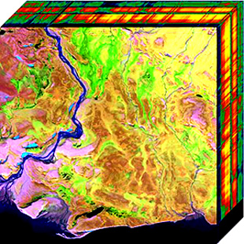
1. Introduction
Hyperspectral image(HSI) restoration:
HSI: contains 2-dimensional spatial information and 1-dimensional spectral information
2-dimensional image --- Matrix
3-dimensional HSI --- Tensor

Slide 4
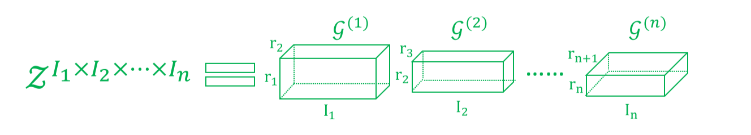
1. Introduction
Tensor decomposition : Tensor-ring decomposition
Tensor a series of third-order factor tensors

Slide 5
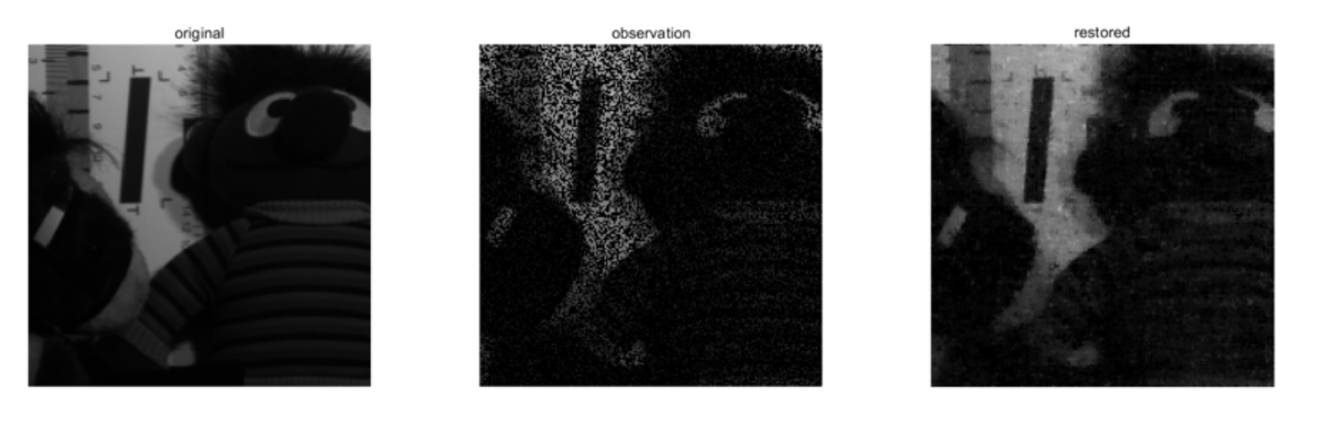
1. Introduction
My research:
Restore the clean HSI from noisy observed HSI which misses some pixels’ information in observation process.
50% observed

Slide 6
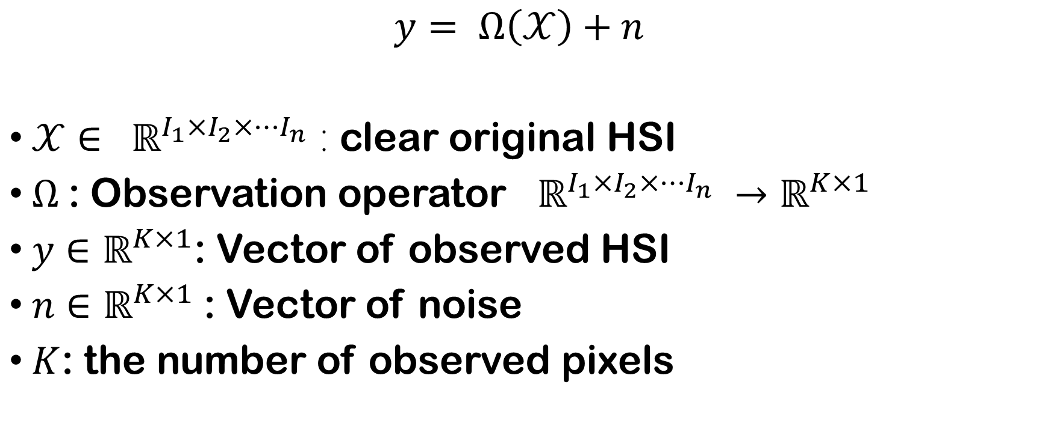
2. Observed model
$$y= Ω\left(𝒳\right)+n$$
$𝒳∈ ℝ^{I_{1}×I_{2}×⋯I_{n}}$ : clear original HSI
$Ω$: Observation operator $ℝ^{I_{1}×I_{2}×⋯I_{n}} →ℝ^{K×1}$
$y∈ℝ^{K×1}$: Vector of observed HSI
$n∈ℝ^{K×1}$: Vector of noise
$K$: the number of observed pixels

Slide 7
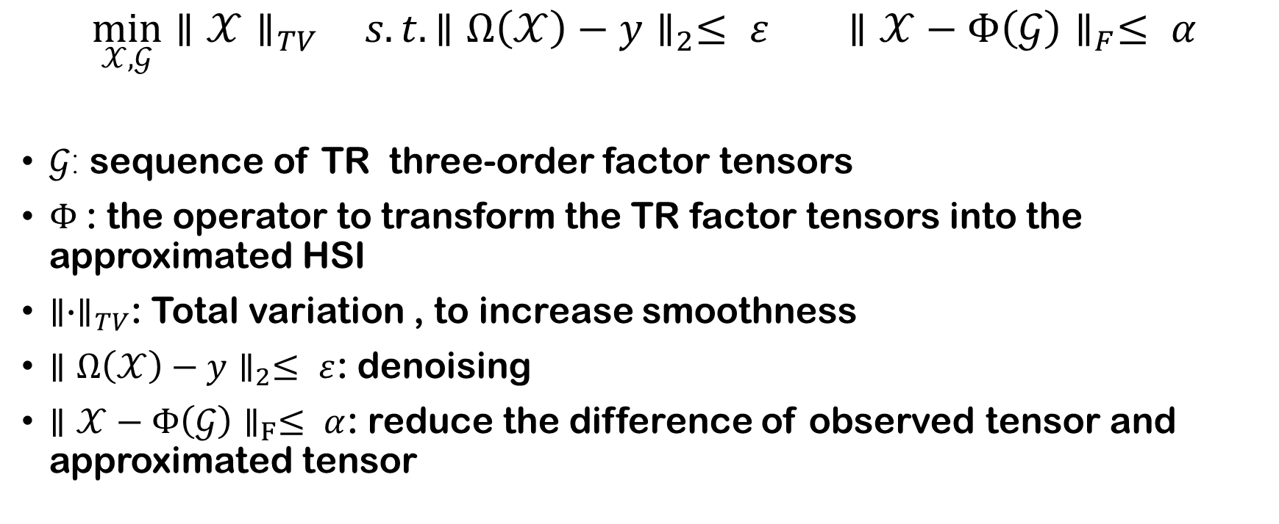
3. Objective function
$$\min_{𝒳, 𝒢}{{∥𝒳∥}_{TV}} s.t. {∥Ω\left(𝒳\right)−y∥}_{2}≤ ε {∥𝒳−Φ\left(𝒢\right)∥}_{F}≤ α$$
$𝒢$: sequence of TR three-order factor tensors
$Φ$: the operator to transform the TR factor tensors into the approximated HSI
${∥∙∥}_{TV}$: Total variation , to increase smoothness
${∥Ω\left(𝒳\right)−y∥}_{2}≤ ε$: denoising
${∥𝒳−Φ\left(𝒢\right)∥}_{F}≤ α$: reduce the difference of observed tensor and approximated tensor

Slide 8
4. Optimization method
Primal-dual splitting method
ADMM

Slide 9
5. Present result and further research
K = 0.5;
noise = 10/255;

Slide 10
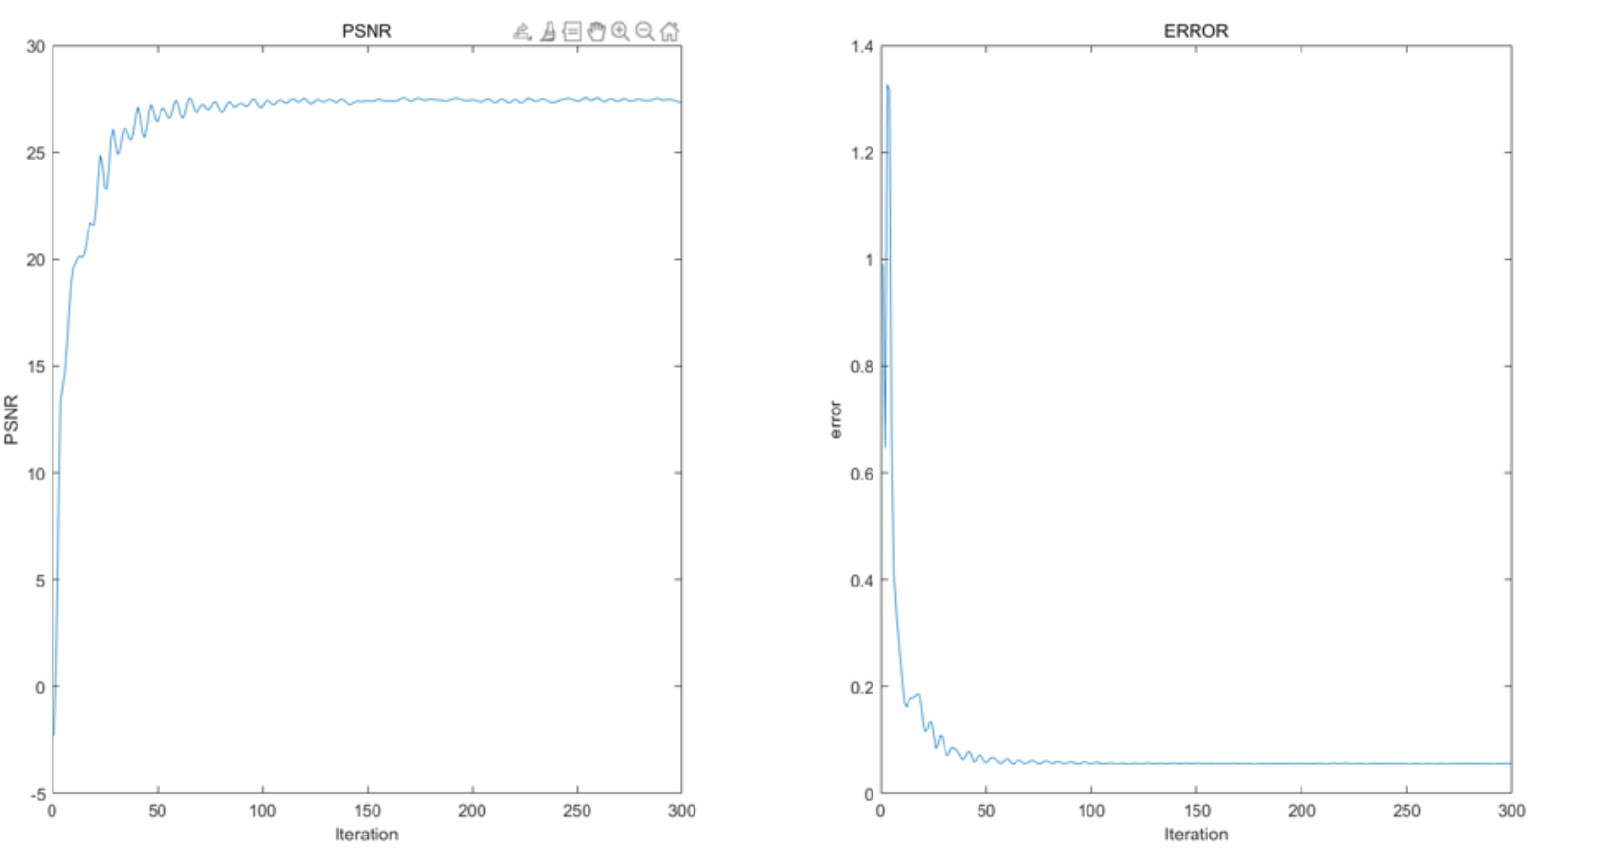

5. Present result and further research
${ERROR}^{(n)}= \frac{∥𝒳^{\left(n+1\right)}−𝒳^{(n)}∥}{∥𝒳^{(n)}∥}$

Slide 11
5. Present result and further research
Modify algorithm and promote performance
Try other types of noise
  Pepper and salt noise
  Stripe noise
Try other types of HSI
  4-dimensional video

Slide 12
That’s All. Thanks for listening.

